Slide 1
Data Science Centre of Excellence
The R&D department in Data Science at STC!
Yanick Beaucage and Kenneth Chu
May 2nd, 2019

Slide 2
Data Science Centre of Excellence
Who are we?
What is our role?
What are our projects?
What has our role been during pilot session of the Digital Academy?

Slide 3
Mathematical and statistical background Experience in statistical programs and survey methods Knowledge of data science techniques
Methodologists
Informatics
Analysts
Notes:
The DSCoE was launched in January 2019. People from many fields such as
Methodologists : ensure that state-of-the-art statistical theory and survey methods are developed and used by the programs of Statistics Canada
Analysts : are in contact with the users, ensure that estimates are sound and tell the story behind the numbers
Informatics : ensure that we have an IT infrastructure reliable and secure, and includes programmers that develop production tools for programs
All of these people can be part of the centre but what unifies them would be
- Mathematical and statistical background to understand the theory behind data science - Experience in statistical programs and survey methods will help them understand when and how to use data science - Knowledge of data science techniques is a must but not just the techniques; the assumptions and parameters behind them as well

Slide 4
Mathematical and statistical background Experience in statistical programs and survey methods Knowledge of data science techniques
Methodologists
Informatics
Analysts
Knowledge of open-source tools
(R, python, …)
Able to understand, assess and apply data science techniques
Able to draw from the similarities between the methods used in the so-called classic methodological approaches and those used in data science
Notes:
They need to have characteristics similar to those of data scientists such as
- Knowledge of open-source software tools (R, python, …)
- Or being able to understand, assess and apply data science techniques
But also, since Statistics Canada has been a survey world for so long the need to make the link between the methods used in so-called the classic methodological approaches and those used in the data science
In fact, our core values are *next slide*

Slide 5
Mathematical and statistical background Experience in statistical programs and survey methods Knowledge of data science techniques
Methodologists
Informatics
Analysts
Our core values are
Quality
Rigour
Providing valid statistical inference
Notes:
As a National Office of Statistics we need to stand behind our numbers and ensure that estimates that we put out there represent valid statistical inference to the population of interest
This is why we need to be rigorous in the way we develop our methods or acquire, process and analyse our data. We make sure at every step that the proper methods are used to deliver a product of the best quality possible. When I mention quality, I do not mean the quality of the estimates per say, put the quality of the process that generated the estimates.

Slide 6
Consultation and guidance
Use advanced techniques and contribute
Advice on ethics component of AI-related work
Evaluate and provide training activities
Lead and conduct research
Mission statement:
Provide scientific backbone for data science activities
Notes:
Consultation and guidance on the application of advanced data science methods for data creation, processing and analysis
Directly contribute to data science pilot and exploratory projects using advanced techniques (e.g. predictive analytics)
Lead and conduct research to support and advance the applications of DS for the production of official statistics
Evaluate and provide training activities to advance DS capacity
Support and advice on ethics component of AI-related work.

Slide 7
Projects
Notes:
I will now say a few words on our current projects and projects that are coming up. The team is mostly Kenneth and myself for now, but we will have 3 students to help us during the summer and 2 new persons on the team in the coming months. This will give a break to Ken ☺

Slide 8
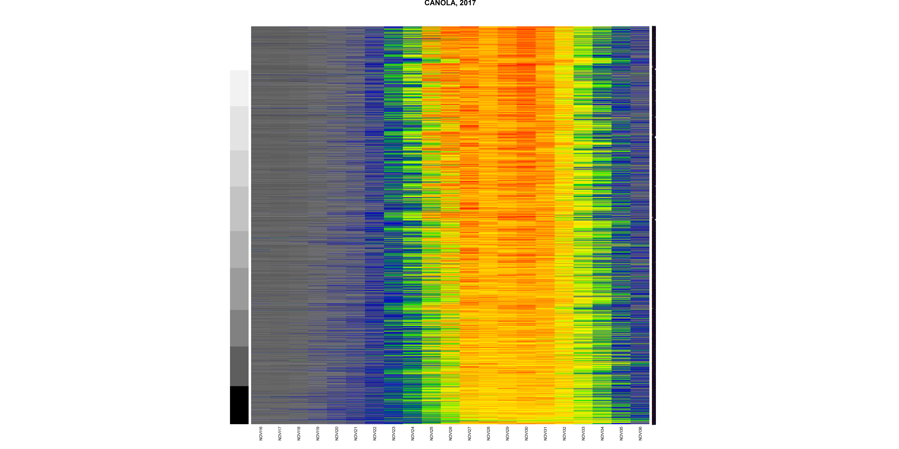
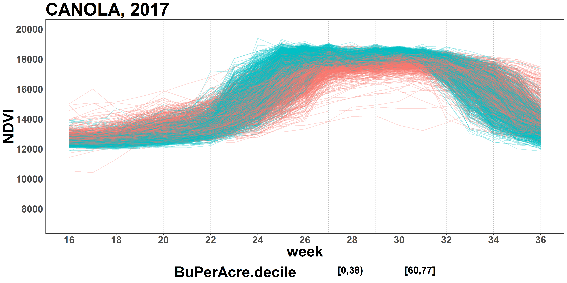
Develop predictive analysis for the crop yield survey
Using vegetation index from satellite images, climate data, crop insurance data (potentially)
Expand current model using historical data in order to predict final yield early in the season (July)
Publish estimates with greater precision
Notes:
One of our projects is with the Agriculture Division at Statistics Canada. They obtain from satellite images a weekly vegetation index of the land. On the right hand side one can see the density of the vegetation index where a colder color means less density and a warmer color means more density. Each row represent a parcel of land and they are ordered from the smaller yield to the largest yield from bottom to top. To add to this, we have also access to climate data and to other sources such as crop insurance data which provides the type of crop.
The goal would be to use data science techniques to develop a predictive model based on historical data and transfer forward this model to predict the final yield as early as July! Note that right now, Statistics Canada is already using a regression model to produce predictions. This model uses variables such as the highest value of the vegetation index or the time this index starts to be larger than a given value. The middle graph is contrasting the larger yield (top 10% in aqua) with the smaller yield (bottom 10% in peach). Maybe using the shape of the vegetation index curve is a better predictor than using the two vegetation statistics, this is what we want to study.

Slide 9
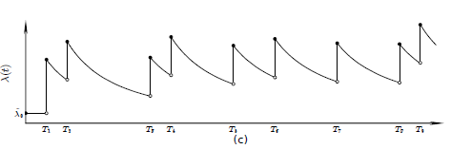
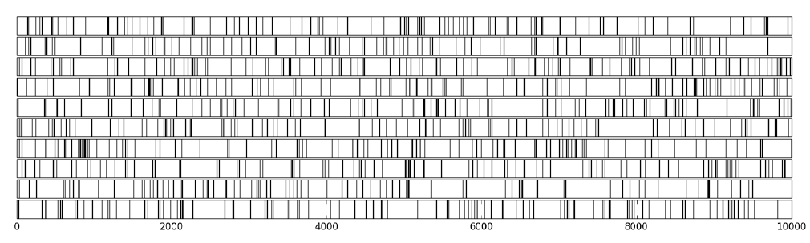
Develop a life trajectory model for the opioid crisis
Using data from multiple sources (opioid events, health, criminal justice, employment, …)
Develop a model to predict the likelihood of having an overdose
Help authorities re-direct people to proper care after determining their trajectory
Notes:
Another project is with the Analytical Studies Branch of Statistics Canada. They were given a file of people having experienced at least one opioid event, fatal or not, in the last two years in BC. They attached to this file different sources of information including, health information, prescriptions, dealing with criminal justice, employment status, etc… having all that information, we want to develop a model to predict the likelihood of experiencing an overdose based on recent past history. This model is based on the intensity of experiencing certain events as shown on the top graph where the intensity rise after each event before slowly reducing based on a decay function. The number of events of each type and their intensity, as shown on the bottom graph, are used to come up with the likelihood of an overdose event. Should we have a different model based on characteristics of the population? In other words, do we need to account for the possibility that the opioid cohort might be a mixture of several subpopulations, each having its own intensity? This should be evaluated as well. But in the end, we hope the model will explain enough to help authority provide proper care to people showing high risk of experiencing an event.

Slide 10
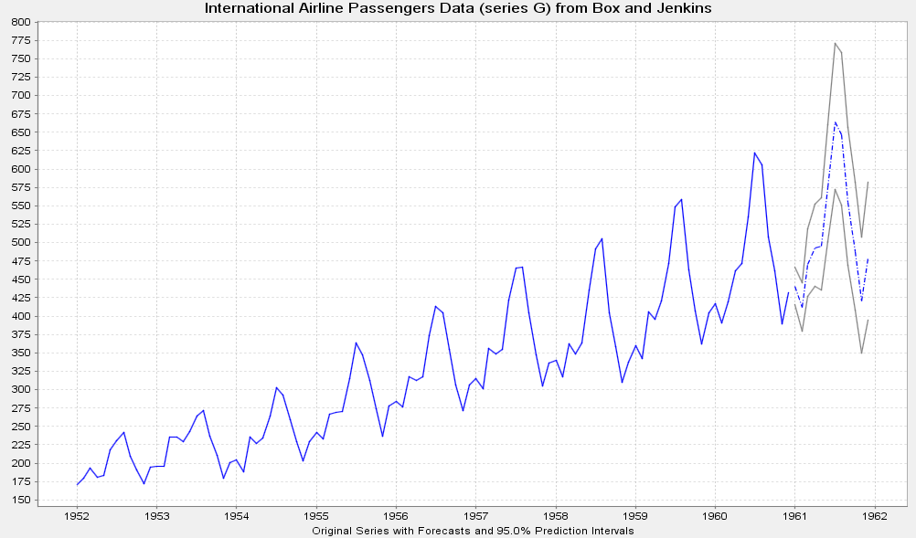
Research project
Real-time statistics
Using times series predictions and realisations in a given domain
Current monthly estimates are produced 2 months after the reference month
Can we come up with better prediction than regular forecast during the reference month?
Notes:
At Statistics Canada, we often deal with time series and we have many tools to produce them including ARIMA models. One of the nice features is it can forecast (with a certain variability) the coming months as shown on the graph. There is also a need for real-time statistics and one solution might just be predictions based on models. But can that prediction be improved using data science techniques? Can we make use of other economic indicators to come up with a better prediction? Can we use sentiment analysis to help us predict the direction of these changes? These are all questions that we will want to help our time series team answer! This research project will tell us if we can produce real-time statistics with quality and rigour!

Slide 11
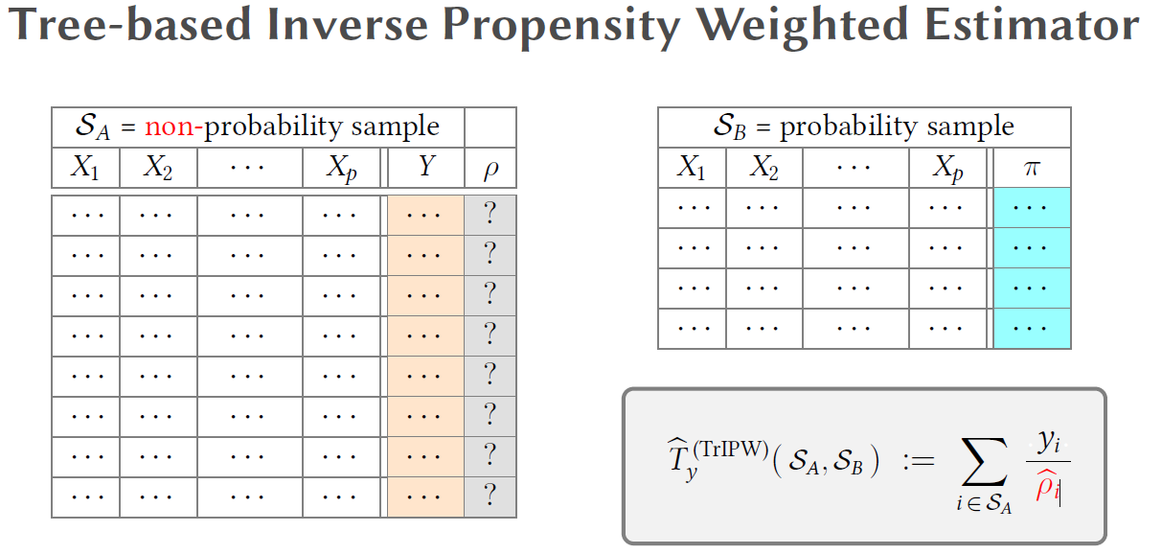
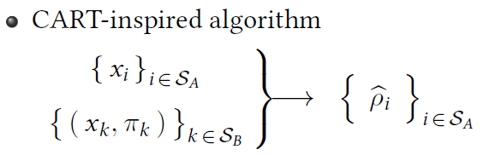
Produce estimates from a non-probability sample (NPS)
Using CART with demographic variables
Calculate the probability for each respondent to be in the NPS
Use it to weight the NPS and evaluate the variability and bias
Notes:
One last example is a research project that Jean-François Beaumont and Ken recently developed and that will be presented at the coming Statistical Society of Canada annual meeting in Calgary. This project is about producing estimates from a non-probability sample for which we would have estimated selection probability based on auxiliary information available in both the NPS and a probability sample. The goal is to try to measure the propensity in the NPS using information from the probability sample. Once a propensity is derived, we can produce an estimate. Although there are other methods to do something similar, they try to see whether a tree-based methodology may be more robust to departure from the model assumptions on the relationship between Y and X, and that between the propensity and X.

Slide 12
Infrastructure
Help to develop an appropriate IT infrastructure for data science projects
GPU, HPC, Cloud, computing cluster are options currently investigated
Develop and lead training activities
Be an active member of the STC Machine Learning Community of Practice
Ensure proper training is available to staff when needed
Notes:
Two other items to work on are the infrastructure and the training. These go hand in hand as we need to develop an appropriate infrastructure so that people that see real benefit of data science techniques are able to apply and test them. These steps need to be done of course with our IT staff which we can help by developing business cases that simulate what needs could be.

Slide 13
How do we produce quality estimates using alternative sources of data?
How do we produce estimates faster and with minimum human efforts?
How do we fully use data science techniques in our statistical programs?
Keep in mind ethics
Challenges
Notes:
Finally, I want to quickly name some of our challenges at Statistics Canada regarding data science. We need to answer these challenges and incorporate the solution in our day to day business if we want to keep being leaders. Our organisation needs to adapt itself to this data revolution!

Slide 14
Statistics Canada at the DA
Provide teaching assistants
Provide specific short courses
Provide data sets to play with
Act as a consultant if needed
Notes:
For this pilot, Statistics Canada was able to provide help in the following domains. Maybe we will continue our partnership!

Slide 15
THANK YOU / MERCI
Pour de plus amples renseignements, veuillez contacter: For more information, please contact:
Yanick.Beaucage@canada.ca
Kenneth.Chu@canada.ca
The content of this presentation represents the position of the authors and may not necessary represent that of Statistics Canada. Methods described may be planned approaches that have not yet been implemented in Statistics Canada’s programs.

